Slide 1
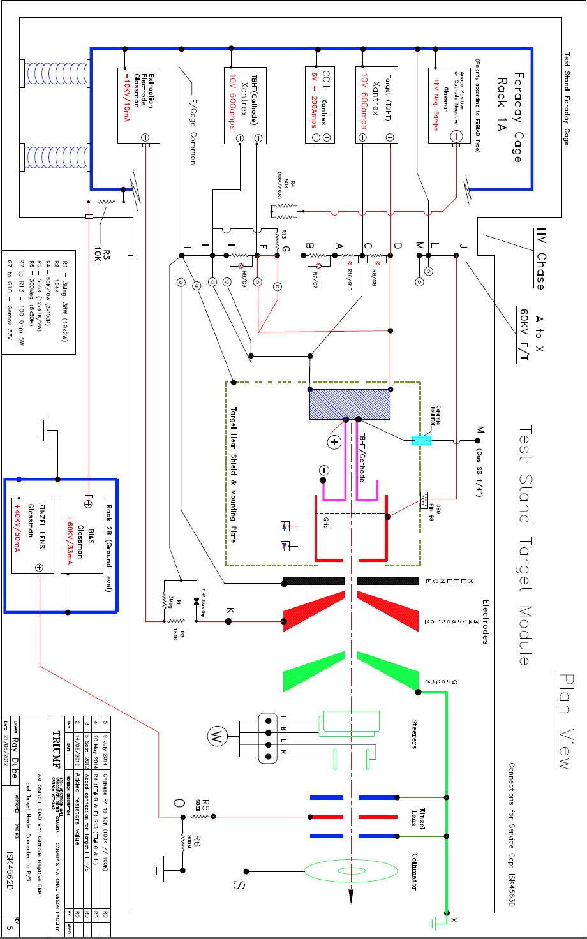
M
N
Green = Braided cable
Light blue = one 4/0 cable
K
L
I
J
G
VAR
H
A1
A2
+ TBHT -
Target+
(slave)
E
VAR
F
Target-
(slave)
D1, D2, D3
B1, B2
- TGHT +
Target-
C
VAR
D
Target+
C1, C2, C3
Tube+
A
VAR
B
Tube-

